Slide 1
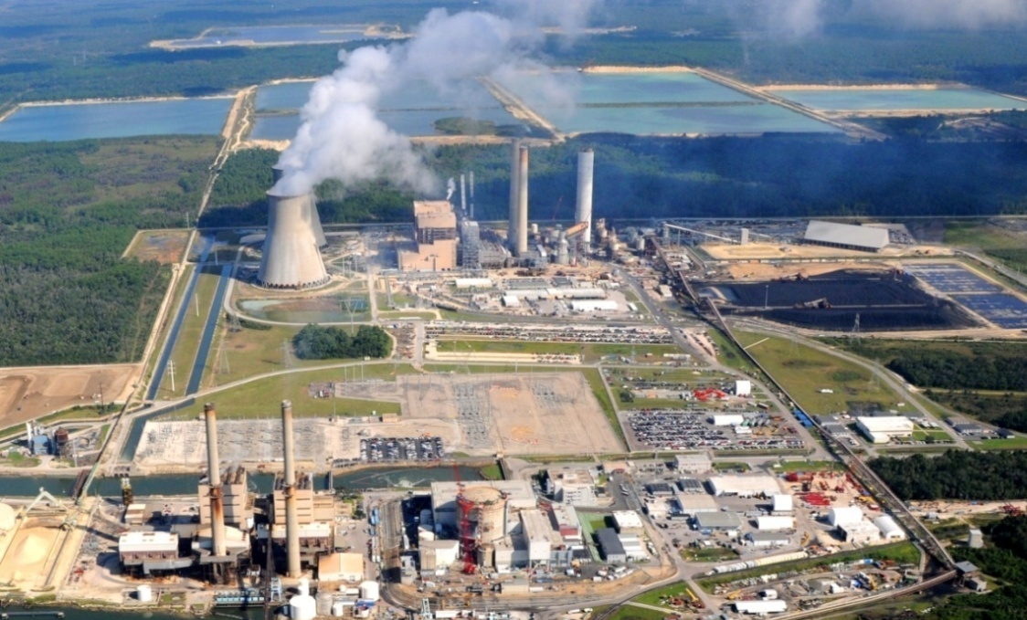
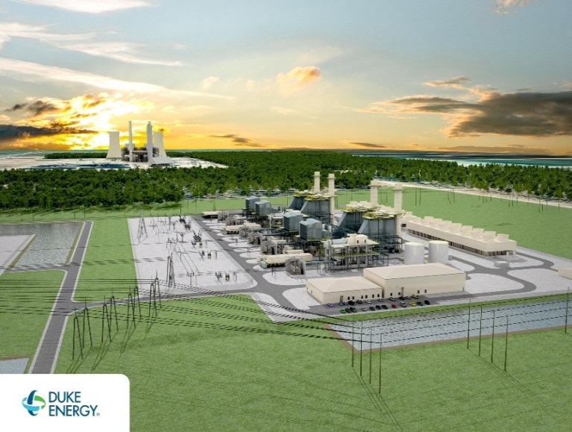
CR3 and Crystal River Energy Complex
Notes:
Crystal River Nuclear Plant
The Crystal River Nuclear Plant (CR3) was capable of generating 860 megawatts (MW) of electricity when in service and during that time helped supply power to approximately 1.7 million customers in Florida. The plant went into service on March 13, 1977, and currently employs approximately 150 people, excluding contractors and security personnel.
If needed
Duke Energy owns 91.8 percent of the Crystal River Nuclear Plant. Nine other utilities own 8.2 percent of the plant, including the City of Alachua, City of Bushnell, City of Gainesville, Kissimmee Utilities Authority, City of Leesburg, New Smyrna Beach Utilities Commission, City of Ocala, Orlando Utilities Commission and Seminole Electric Cooperative, Inc.
Crystal River Energy Complex
The Crystal River Energy Complex also includes four coal-fired generating units. The complex is 4,700 acres and represents the largest energy complex on the Duke Energy Florida system. The four coal-fired units produce 2,290 megawatts of generation.
If needed
Units 1&2 = 915 MW
Units 4&5 = 1,536 MW
Unit 1, Built in 1966, 395 MW
Unit 2, Built in 1969, 520 MW
Unit 4, Built in 1982, 769 MW
Unit 5, Built in 1984, 767 MW
Fossil employees = 345 total
Natural Gas Plant
In May 2014, we announced plans to construct a combined-cycle natural gas plant to supply 1,640 megawatts of generation to help serve Florida’s approximately 1.7 million customers in 2018.
If all required approvals and permits are received, the plant will be built on 400 acres near the Crystal River Energy Complex. Construction is expected to start in early 2016. The plant’s first 820 megawatts are expected to come online in spring 2018, and the second 820 megawatts are expected to come online by December 2018.

Slide 2
CR3 2013 - 2019
February 2013
Duke Energy announces the permanent shut down of CR3
There are approximately 600 employees, greater than 200 security officers and several hundred other contractors on site
Duke submits a notice of Permanent Cessation of Operations letter to the NRC

Slide 3
CR3 2013 - 2019
July 2013
Approximately 300 employees remain on site in the Decommissioning Transition Organization (DTO), small reduction in security officers, reduced number of contractors
September 2013
Submitted the permanently defueled emergency plan (PDEP), emergency action level (EAL) scheme change and the request for exemption from emergency planning standards for NRC review
December 2013
Post Shutdown Decommissioning Activities Report and the Detailed Cost Estimate (SAFSTOR option chosen) submitted to NRC and State of Florida
60 + 1 years
$1.18B (2013 dollars)

Slide 4
CR3 2013 - 2019
August 2014
Duke Energy Board of Directors approve the Independent Spent Fuel Storage Installation (ISFSI) project
$173M (trust and regulatory asset)
Additional $9.8 M security project managed by the ISFSI team
October 2014
Commence ISFSI pad construction
December 2014
Completed nuclear island construction
Completed legacy low level radioactive waste shipment project
April 2015
Implemented the Permanently Defueled Emergency Plan

Slide 5
CR3 2013 - 2019
July 2015
Transitioned to the SAFSTOR I Organization
Approximately 70 employees, 110 Security Officers and the ISFSI team (currently 115)
September 2015
Implemented Permanently Defueled Technical Specifications
Made the transition from Nuclear Reactor Regulation to Nuclear Material Safety and Safeguards (NRC oversight).
May 2016
Submitted the ISFSI only security plan and emergency plan to the NRC
June 2016
Received the Historical Site Assessment report

Slide 6
CR3 2013 - 2019
November 2016
Completed the large component disposition project (original steam generators and original reactor head)
January 2017
Complete ISFSI pad Construction
February 2017
Completed shipment of batch 19 fuel to Oconee plant.
June 2017
Commence the spent fuel pool to pad campaign
Dec 2017
Kicked-off update of the Detailed Cost Estimate

Slide 7
CR3 2013 - 2019
January 2018
Completed pool to pad activities
Submitted notification that all fuel removed from the Spent Fuel Pool
Implement ISFSI-Only Technical Specifications
February 2018
Commence spent fuel pool clean-up
Move greater than class C (GTCC) waste from the pool to ISFSI pad
Remove non-fuel components from Spent Fuel Pool
Remove spent fuel racks from Spent Fuel Pool
April 2018
Implement ISFSI–Only Security Plan and ISFSI-Only Emergency Plan

Slide 8
CR3 2013 - 2019
September 2018
Complete Spent Fuel Pool cleanup/draindown
March 2019
Relocate personnel to new office/shop locations
July 2019
Place in service new electrical, Fire Protection and ventilation systems
Complete remaining SSC abandonment
Power Block cold, dark and deenergized
Implement SAFSTOR II (55 people)

Slide 9
CR3 2019 - 2074
Operate, maintain and secure the ISFSI and various power block structures
DOE takes possession of the used fuel and GTCC waste (2036)
Transition to dormancy with no used fuel on site (2036)
Commence D&D planning (2068)
Complete license termination (2073)
Complete site restoration (2074)

Slide 10
CR3 ISFSI Pad

